Slide 1
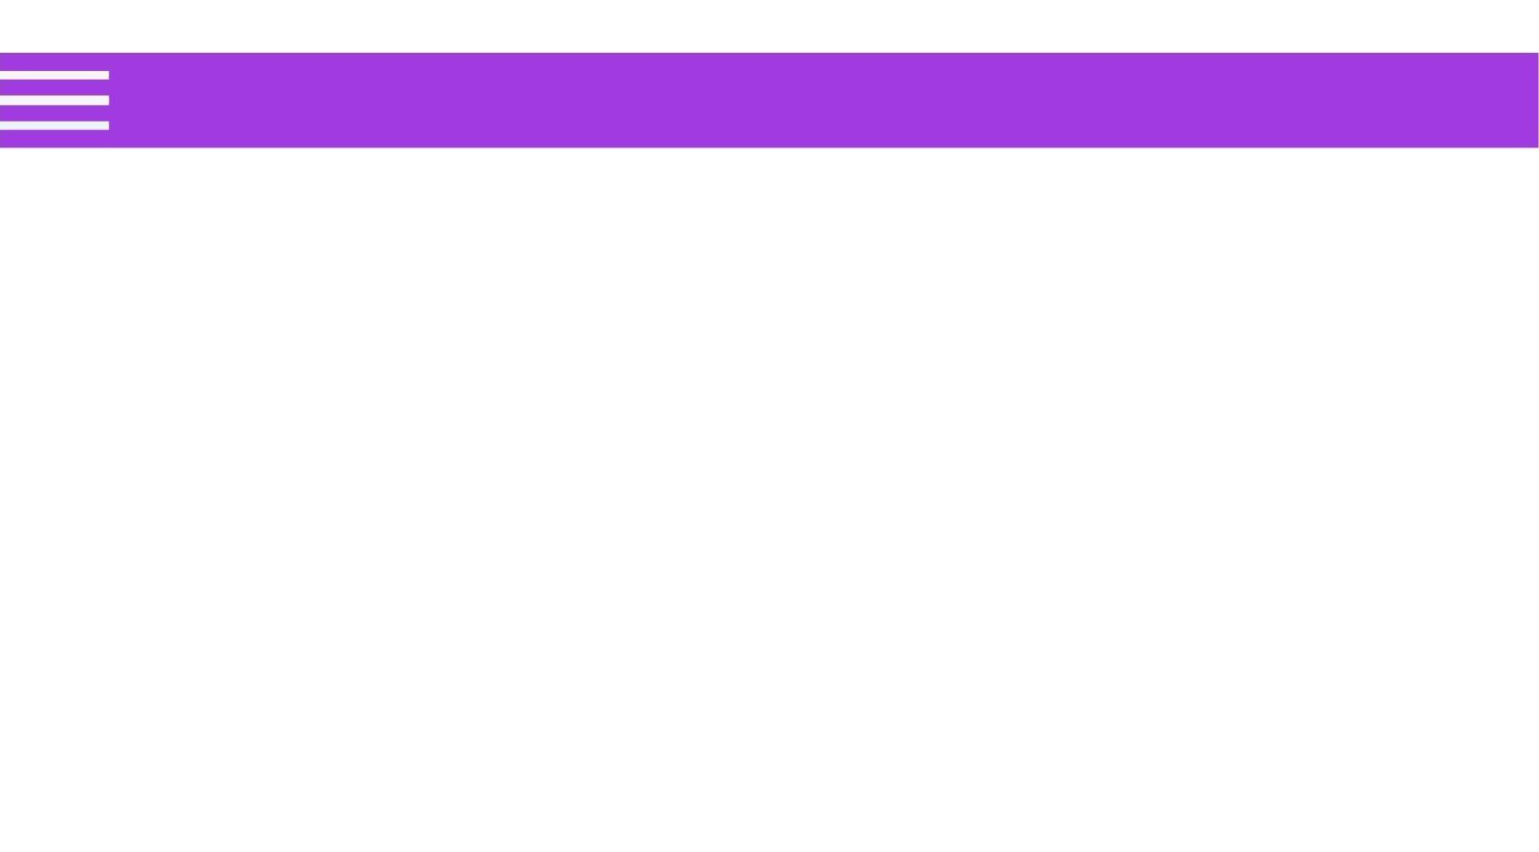
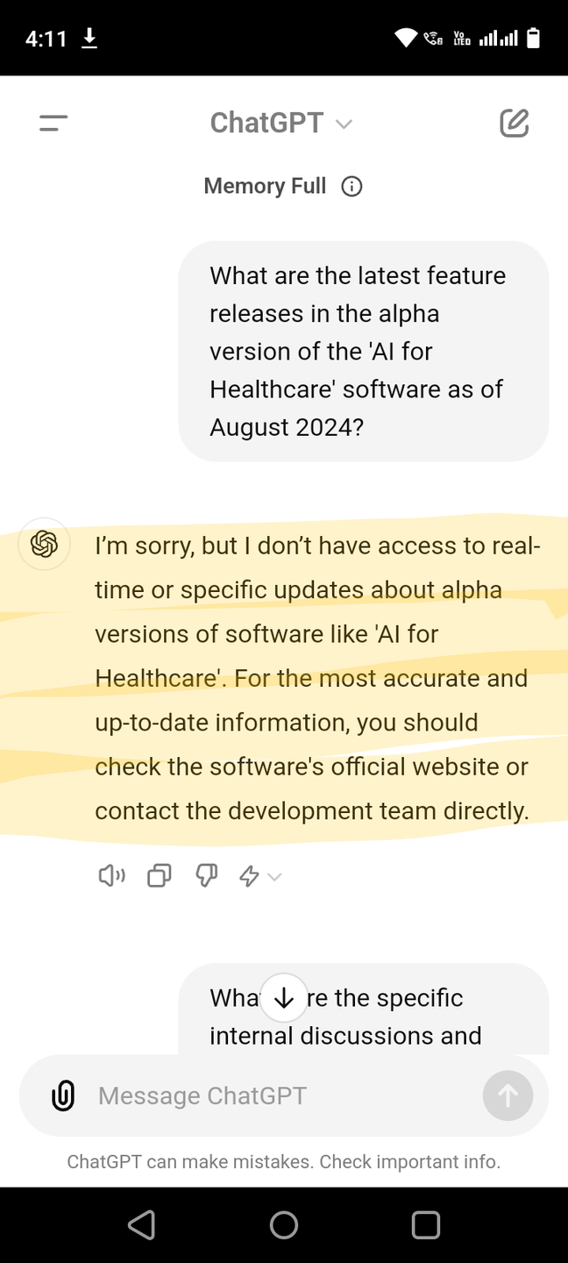

Problem with LLM
Issue: LLMs, like GPT, may not have access to realtime and latest domain specific Information.
Example: A chatbot might generate an
incorrect answer because it doesn't have
access to up-to-date or specific information

Slide 2
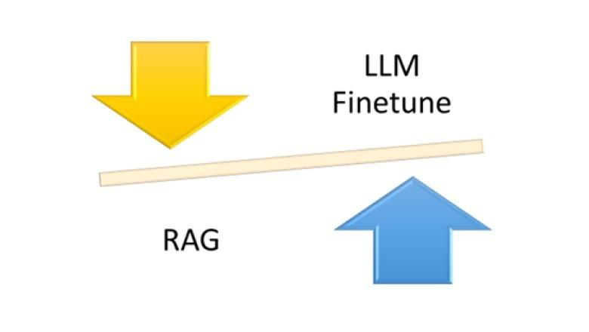
Solution
Finetune with latest data
Retrieval-Augmented Generation / In context Learning

Slide 3

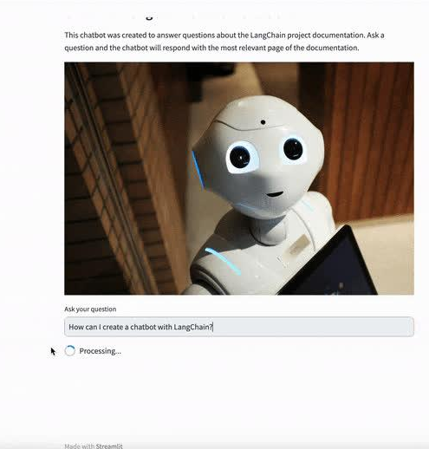
Enter the Hero - RAG
Mechanism: RAG first retrieves relevant documents or data from a knowledge base and then uses that information to generate a response.
Example: Before answering a question about current events, RAG retrieves the relevant articles and uses them to inform its response.

Slide 4

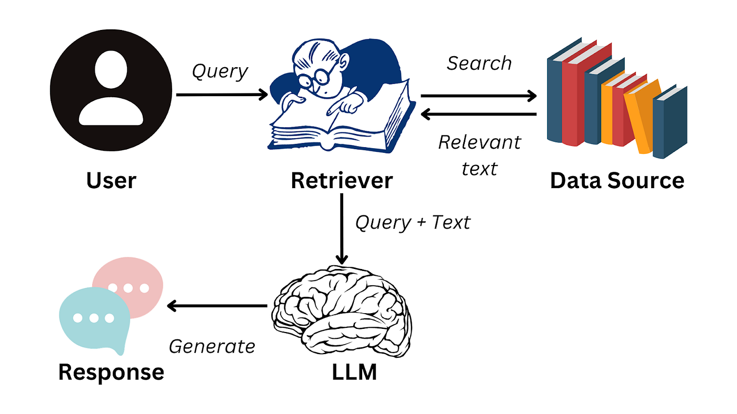
Introduction to RAG
Retrieval-Augmented Generation (RAG): Combines
retrieval-based and generation-based methods.

Slide 5
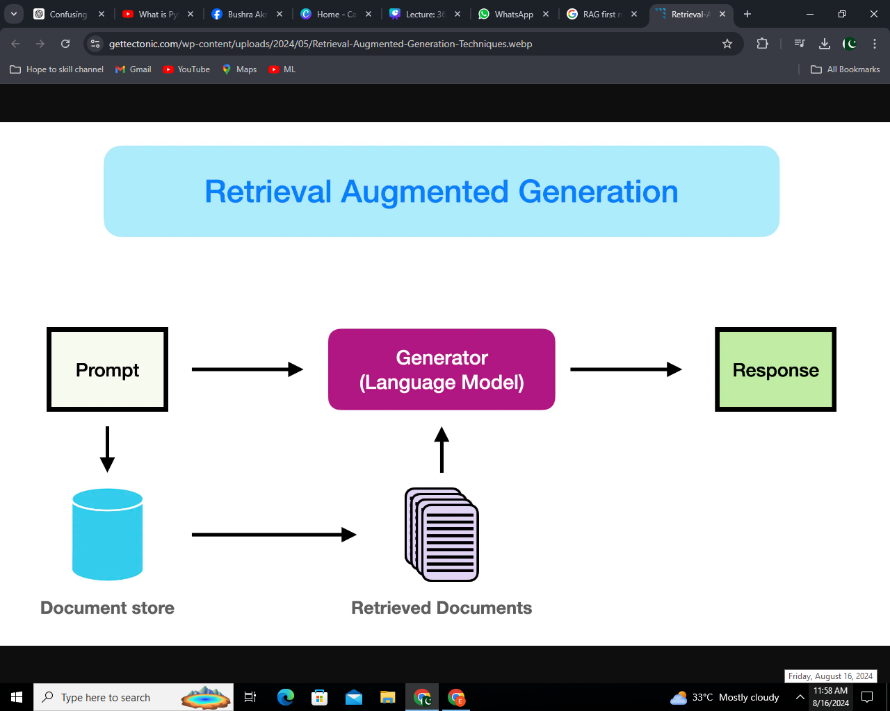
How RAG Works
Query Input: The user asks a question.
Document Retrieval: The retriever identifies relevant documents.
Response Generation: The generator crafts a response using the
retrieved information.
4. Final Output: A factually accurate and contextually relevant answer.

Slide 6
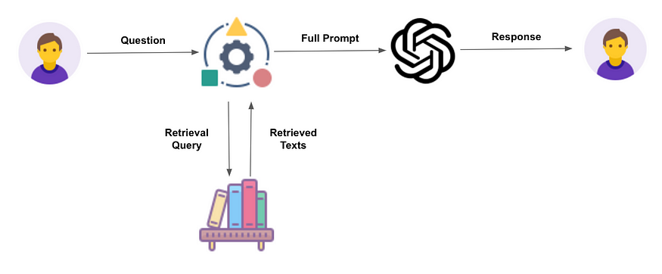
RAG Model

Slide 7
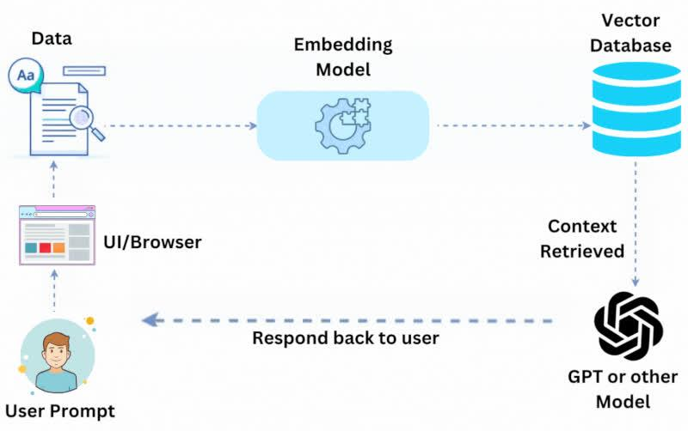
RAG Model
Retrieves relevant documents from a corpus and generates a response based on both the query and the retrieved documents.

Slide 8
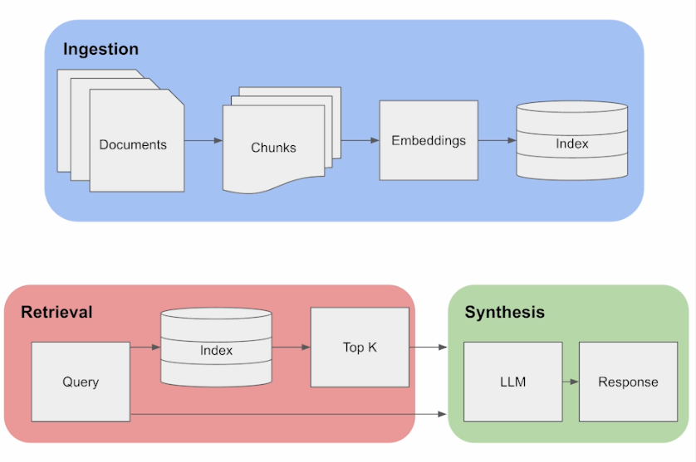
RAG Pipeline

Slide 9
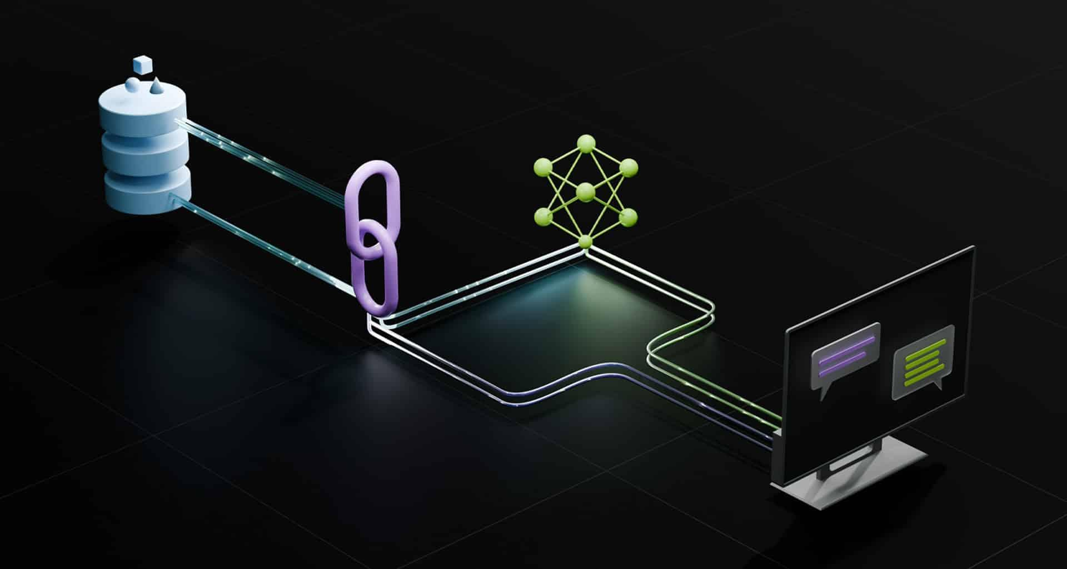
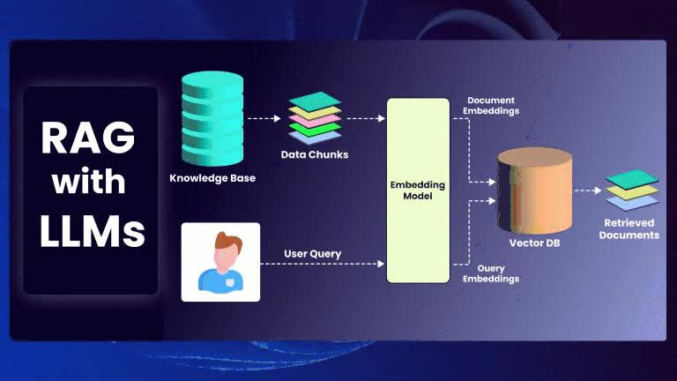
Why RAG - Enhanced Information Access
Best of Both Worlds: Combines retrieval-based
methods for vast information access and
generation-based methods for coherent,
relevant responses.

Slide 10

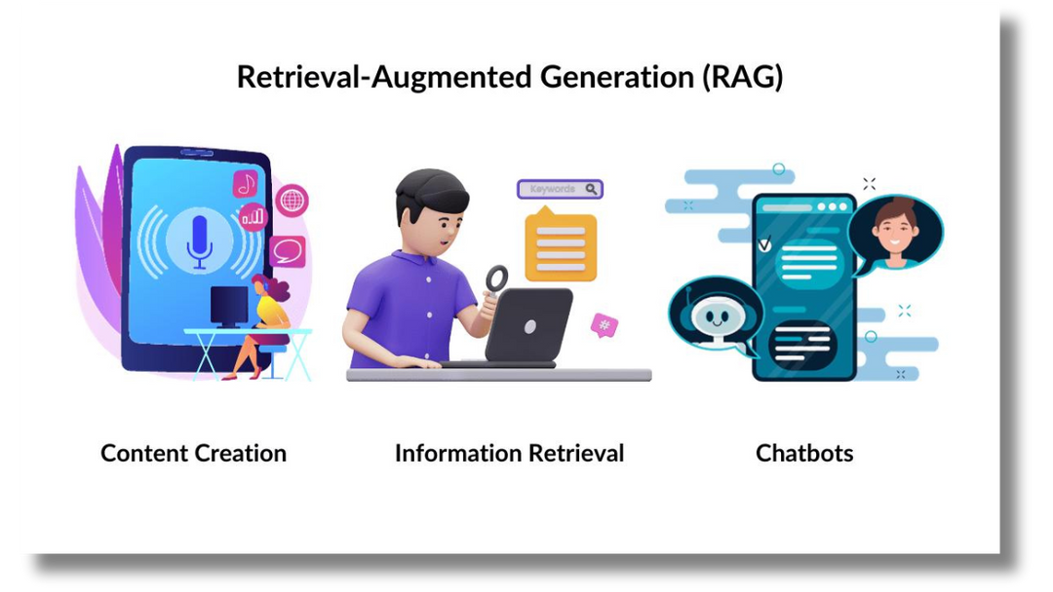
Why RAG - Enhanced Information Access
Accuracy and Relevance: Retrieves documents from a large corpus, ensuring responses are accurate and enriched with useful information.
Contextual Awareness: Maintains context by considering both the query and retrieved documents, resulting in meaningful responses.

Slide 11
RAG Pipeline

Slide 12
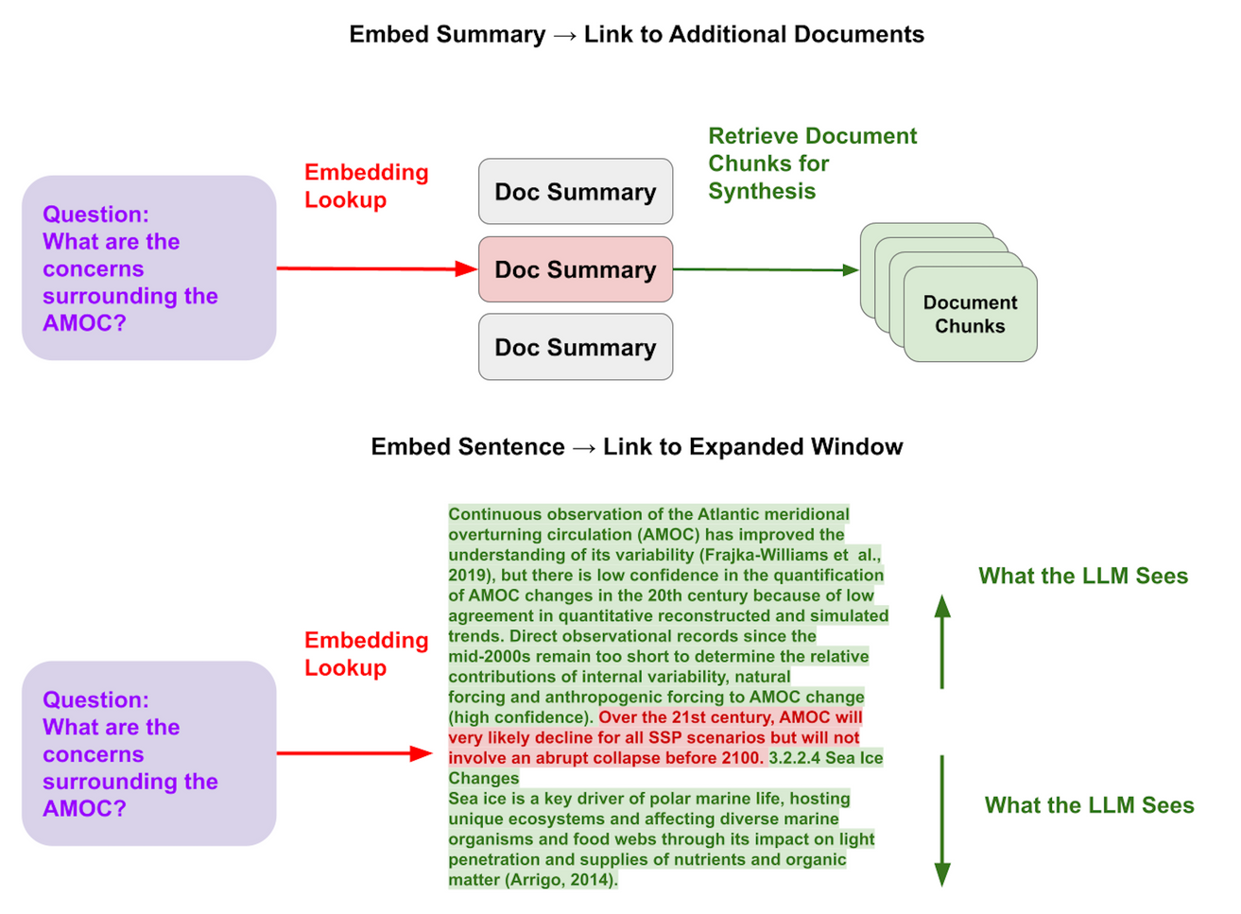
Applications
Improves the performance of tasks like question answering,
summarization, and more.

Slide 13


Advantages
1
Leverages large external knowledge bases.
2
Enhances contextual understanding.
3
Provides more accurate and relevant answers.

Slide 14
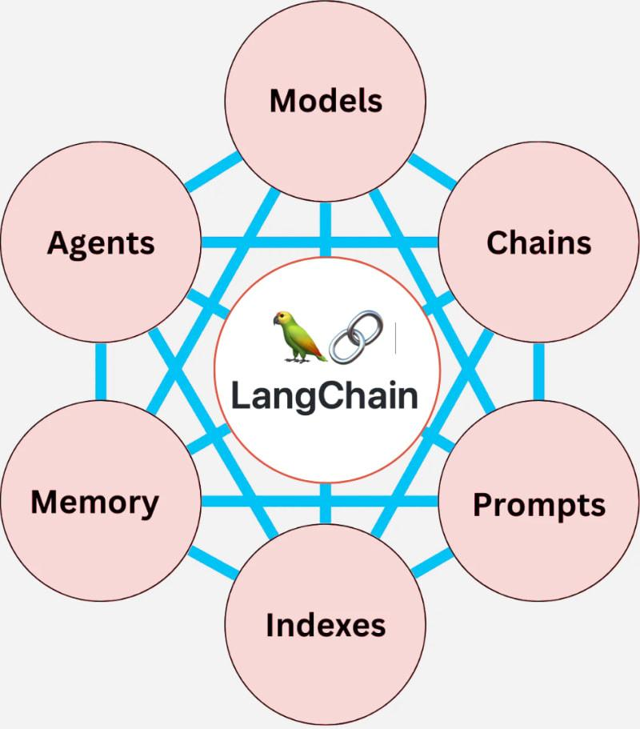
Introduction to LangChain
LangChain: A framework for building applications using language models.
Components: Includes tools for document transformation, connection to various data sources, and chaining multiple operations.

Slide 15
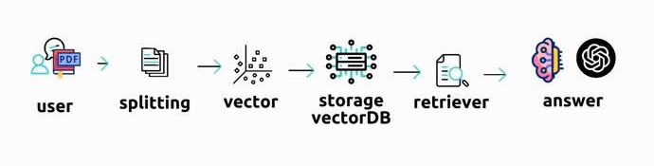
Introduction to LangChain

Slide 16
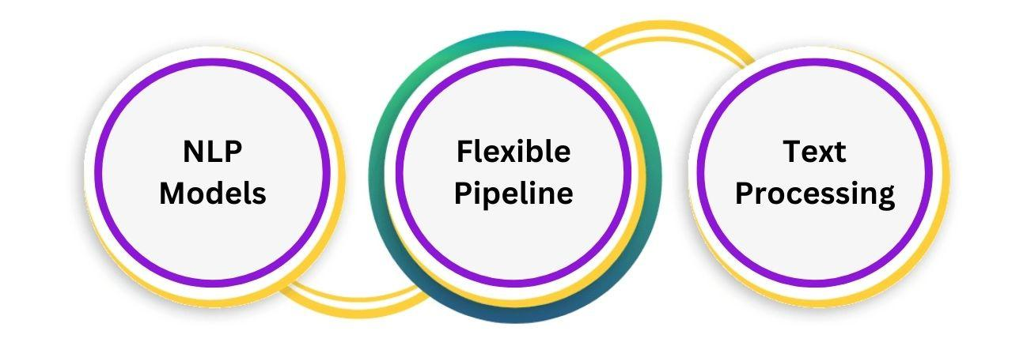
Features
Easy integration with various NLP models, flexible pipeline creation, and support for various text processing tasks.

Slide 17
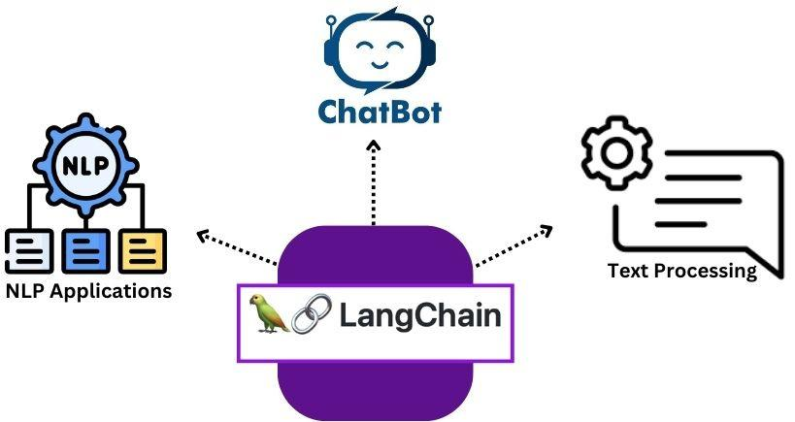
Use Cases
Useful for building chatbots, automated text
processing pipelines, and other NLP applications.

Slide 18
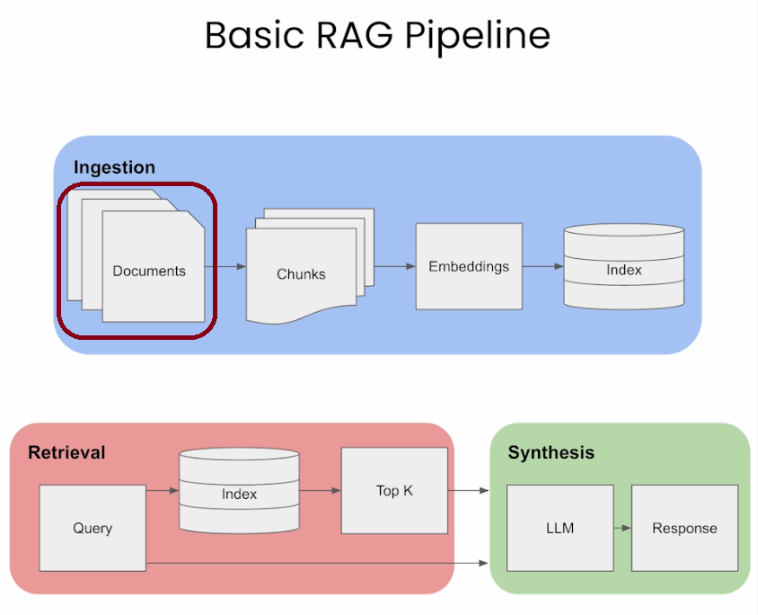
Step 1: Document Loading

Slide 19

Document Loading
Document Loading: The process of ingesting
documents into a system for further processing.
Supported Formats: Includes plain text, HTML,
docs, PDF, and more.

Slide 20
Document Loading
Techniques:
Use of specific loaders for different
formats, handling large documents, and
maintaining document integrity.

Slide 21
Document Loading
Applications:
Preparing data for NLP tasks,
ensuring compatibility with various text
processing tools, and efficient handling
of diverse document types.

